Slide 2

Praveen Raghuvanshi
Cloud Architect, Harman International

Slide 3
Applying Data Science and Machine Learning Using Microsoft .Net
Praveen Raghuvanshi

Slide 4
Acknowledgements
Dataset – John Hopkins University CSSE
Python Visualization – Akshay Sb
Organizers – AzConf 2022
Sponsors

Slide 5
Identify Language
Maidin mhaith
Guten Morgen
おはよ ございます
शुभ प्रभात
Good Morning

Slide 6



Programming Languages
Source: https://insights.dice.com/2019/10/24/tiobe-top-eight-top-ten-open/

Slide 7

Data Science – Exploratory Data Analysis(EDA)
As per Wiki…
“In statistics, exploratory data analysis (EDA) is an approach of analyzing data sets to summarize their main characteristics, often with visual methods.”
Buy a House
No of bedrooms
Type (Apartment, Villa)
Locality
Crime Rate
Source: https://insights.dice.com/2019/10/24/tiobe-top-eight-top-ten-open/

Slide 8
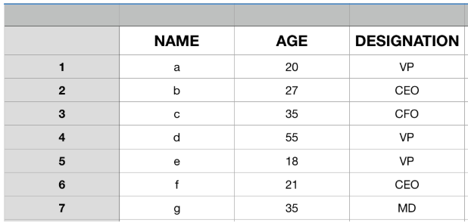
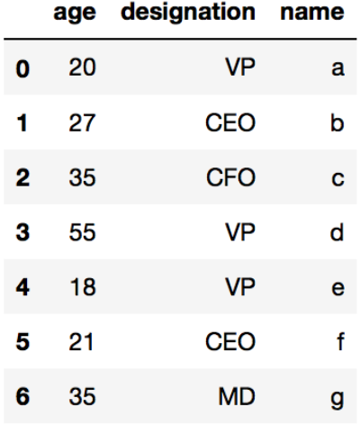
EDA Datastructure : DataFrame

Slide 9
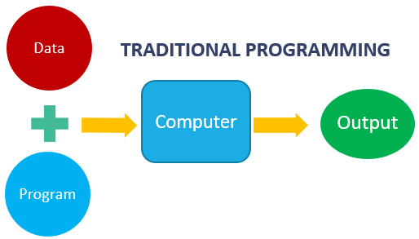
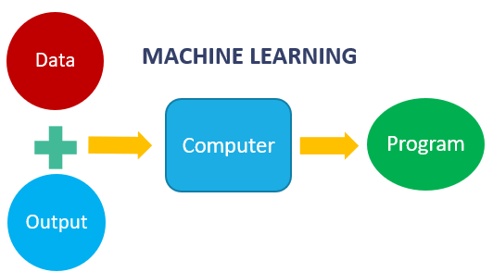
Machine Learning
Machine learning is getting computers to program themselves
If programming is automation, then machine learning is automating the process of automation

Slide 10
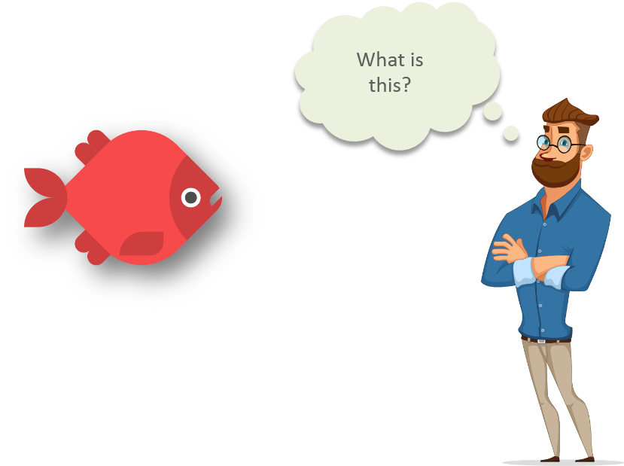
Machine Learning
source: https://www.quora.com/What-are-prerequisites-to-start-learning-machine-learning

Slide 11
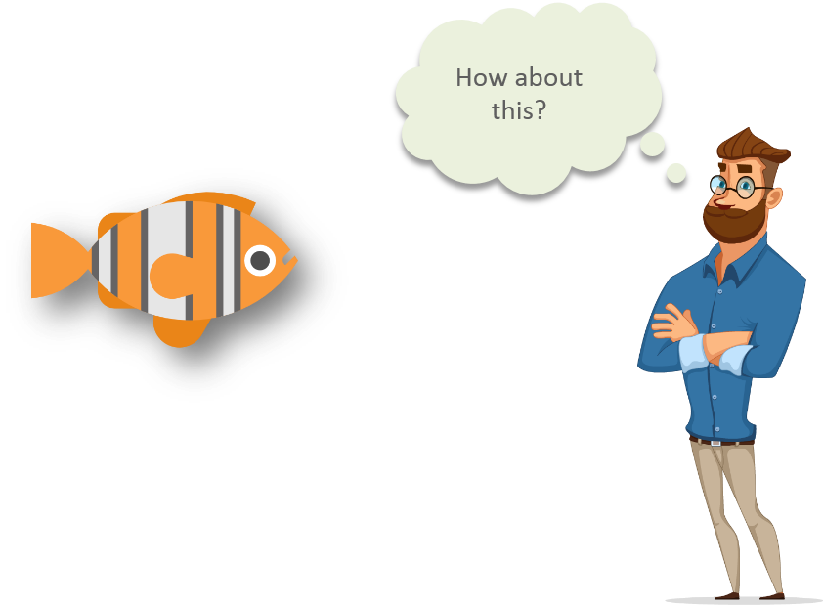
Machine Learning
source: https://www.quora.com/What-are-prerequisites-to-start-learning-machine-learning

Slide 12
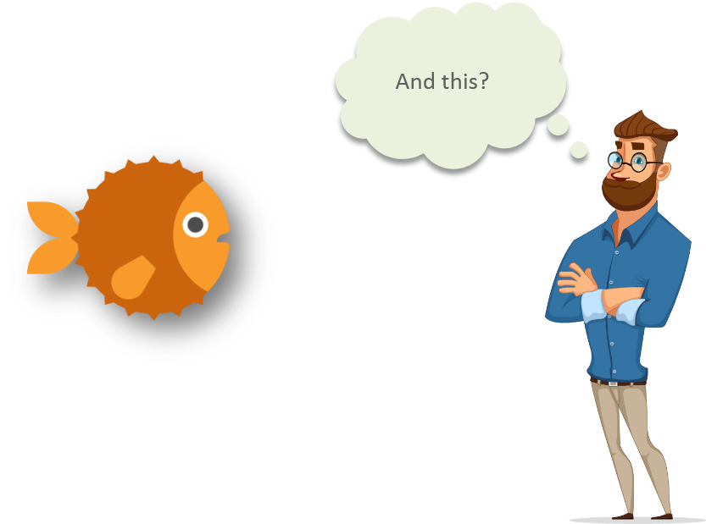
Machine Learning
source: https://www.quora.com/What-are-prerequisites-to-start-learning-machine-learning

Slide 13
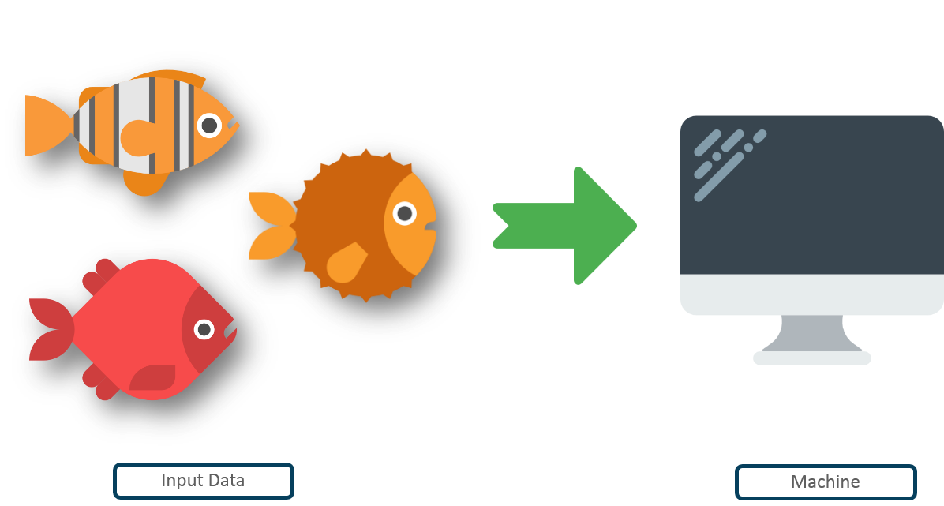
Machine Learning
Input data
Machine
Source: https://www.quora.com/What-are-prerequisites-to-start-learning-machine-learning

Slide 14
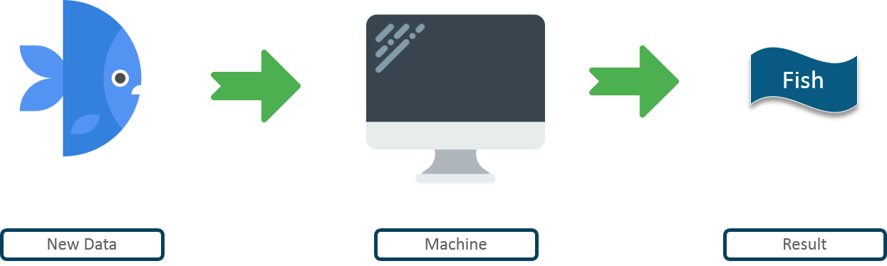
Machine Learning
New Data
Machine
Result
Source: https://www.quora.com/What-are-prerequisites-to-start-learning-machine-learning

Slide 15
Pre-Requisites of ML
A Pattern should exist
Mathematical model/algorithm is unknown
Abundant data

Slide 16
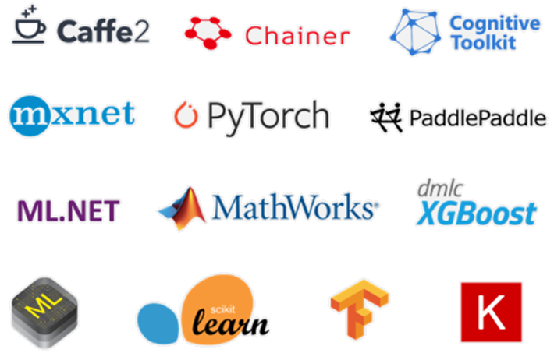
ML Frameworks

Slide 17
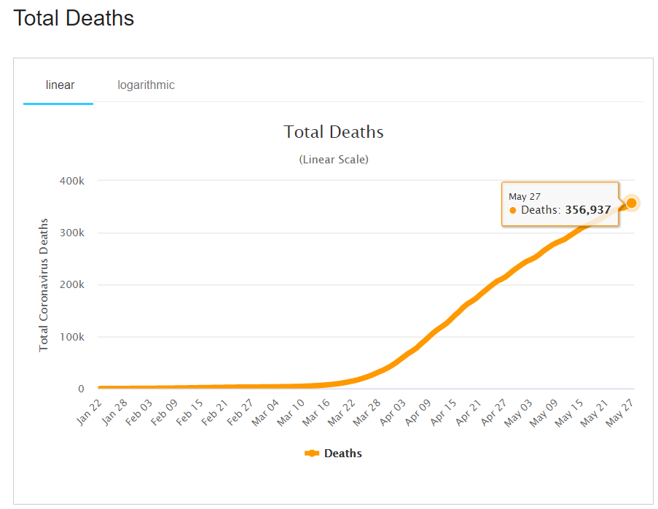
Predictions – Time Series Analysis
The analysis of data organized across unit of time.
It helps understand past trends
Types: Trends, Seasonality, Irregularity, Cyclic

Slide 18

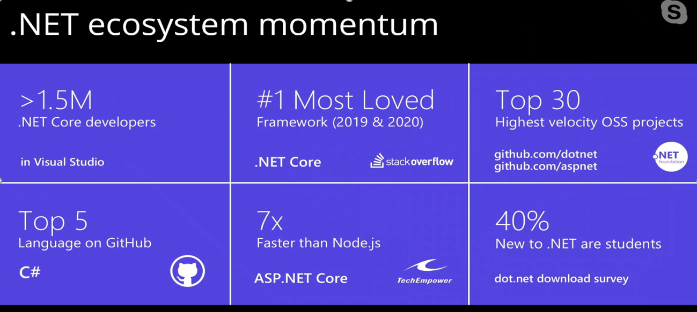
Why ?

Slide 19
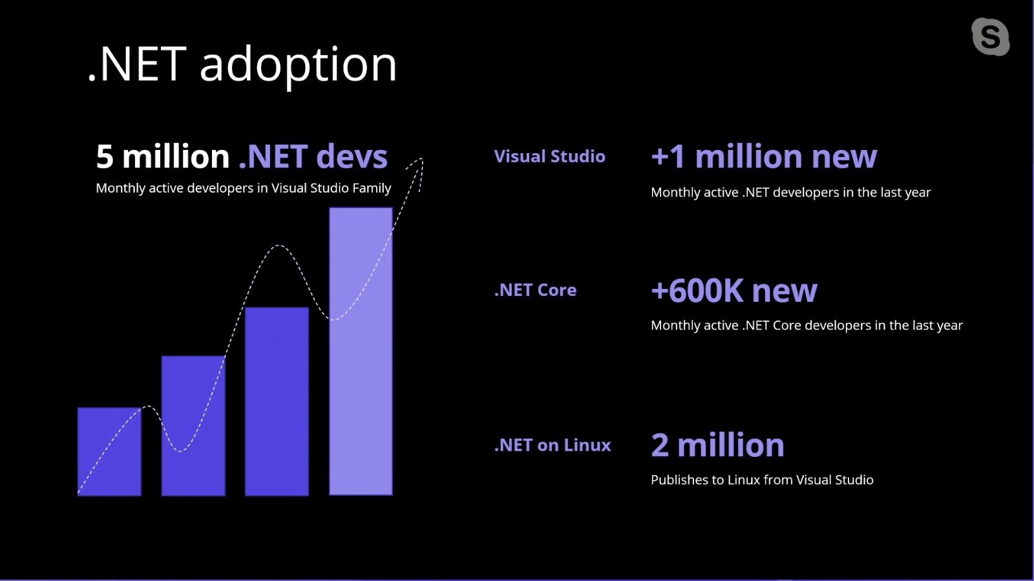
Why ?

Slide 20
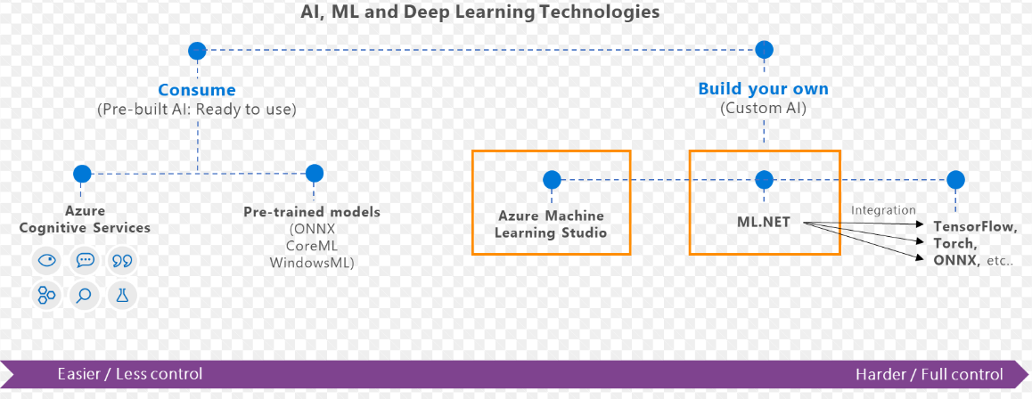
What is ML.Net ?
ML Framework from Microsoft for developing custom AI/ML applications.
Originated in 2002 as part of Microsoft Research Project

Slide 21
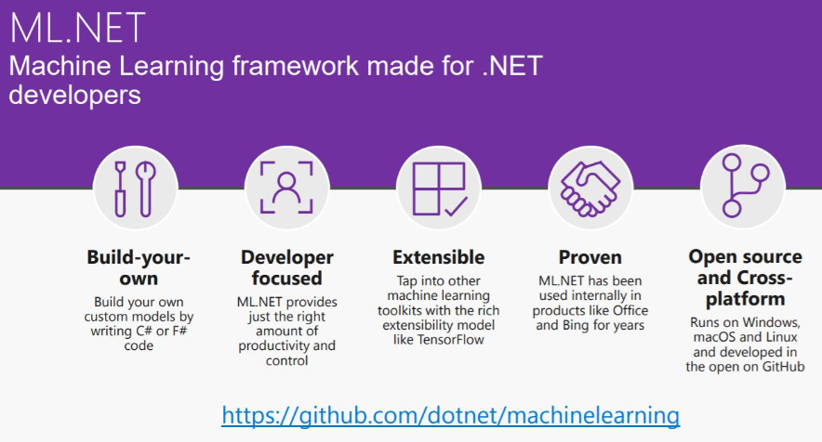
What is ML.Net ?

Slide 22
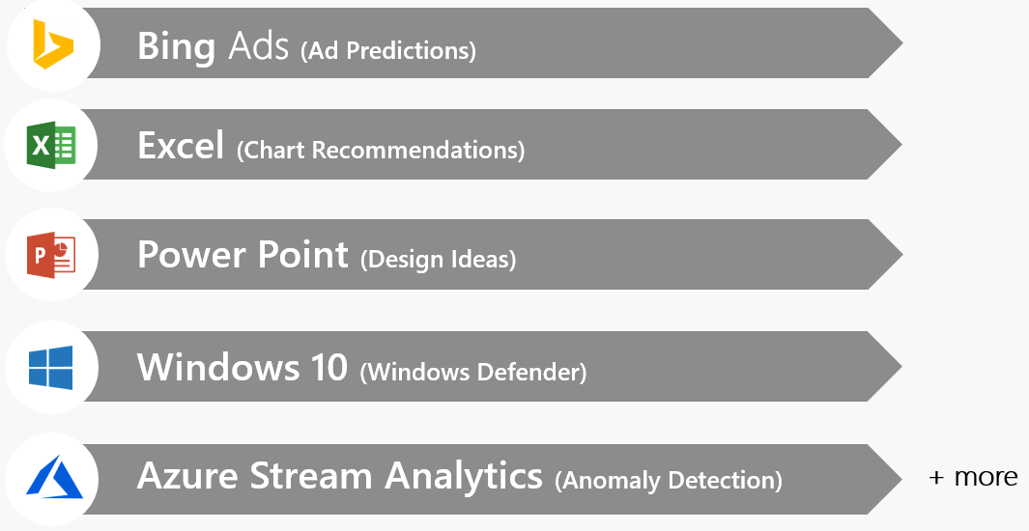
ML.Net – Proven at Scale, Enterprise ready

Slide 23
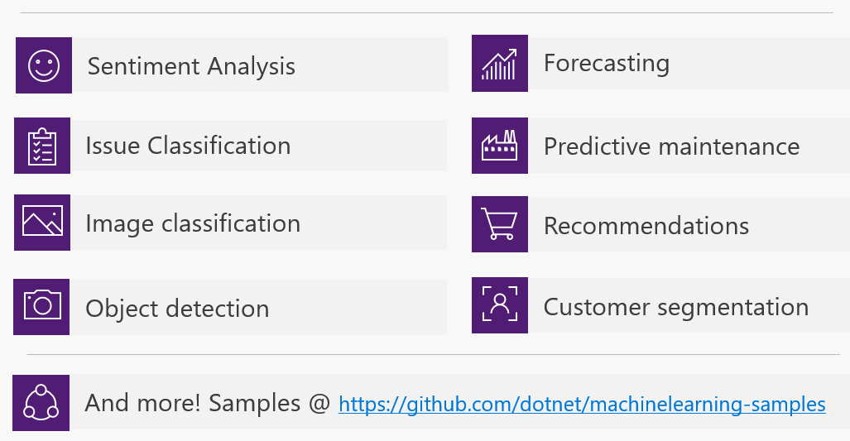
ML.Net – Possibilities

Slide 24
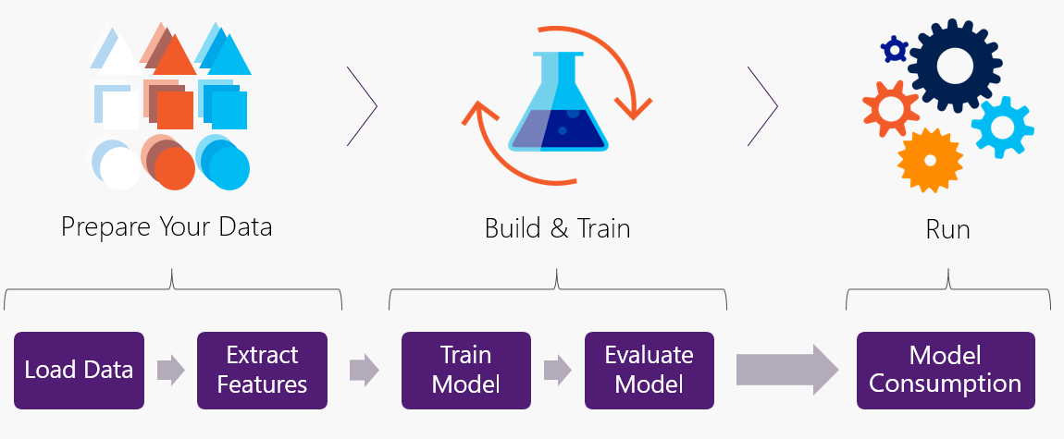
ML.Net – Workflow

Slide 25
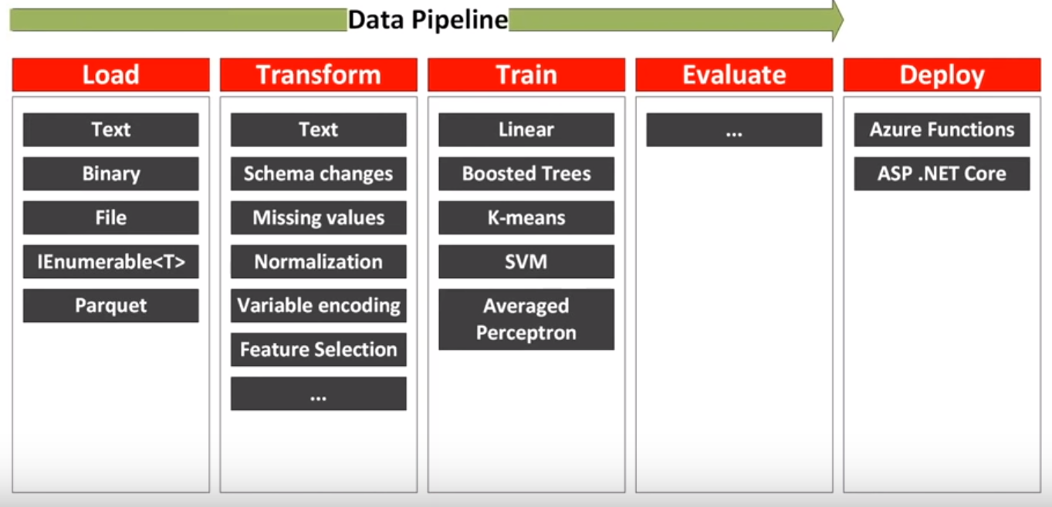
ML.Net – Data Pipeline

Slide 26

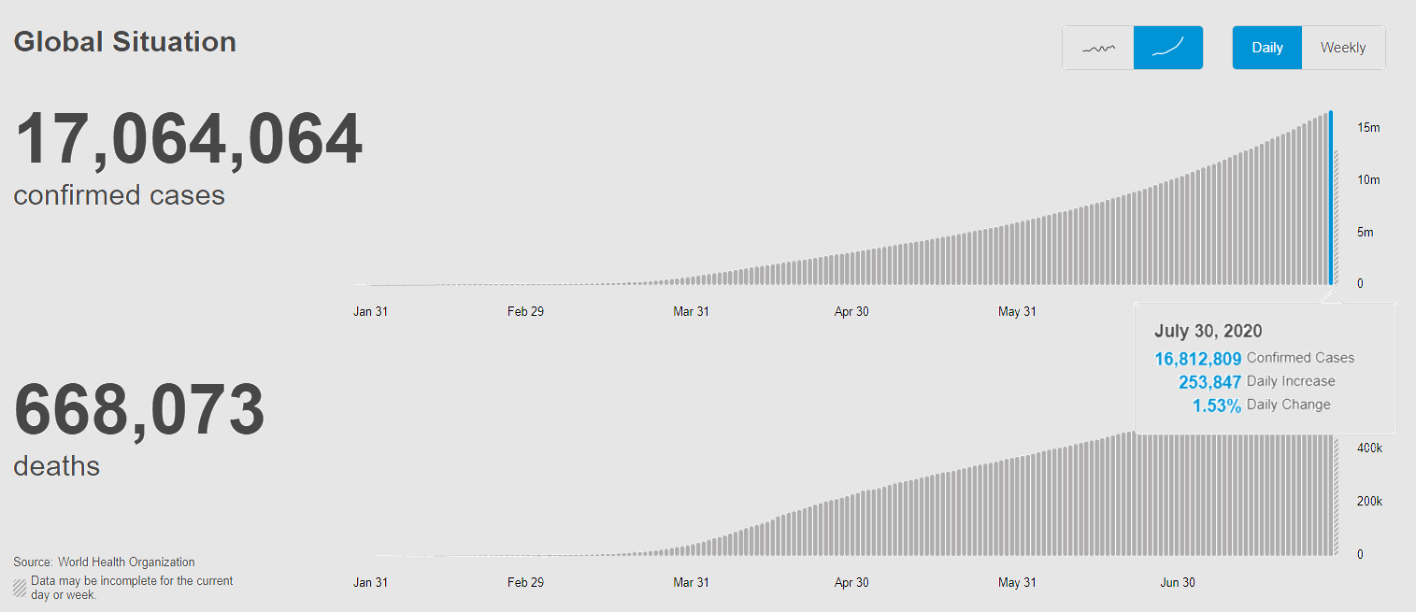
Covid-19 EDA and Prediction
Source: https://covid19.who.int/
Data as on July 30, 2020

Slide 27
EDA using .Net DataFrame
A collection of columns
In-memory representation of structured data
Similar to Python Dataframe
Load dataset from CSV
Row/Column Selection
Join/Merge DataFrame
GroupBy
Null Values

Slide 28
Machine Learning using ML.Net
Time Series
Load Data – MLContext
ML Pipeline
Predict Confirmed cases in next 7 days.
Notes:
Single Spectrum Analysis
TimeSeriesCatalog.ForecaseBySsa
SSA is a powerful framework for decomposing the time-series into trend, seasonality and noise components as well as forecasting the future values of the time-series.
In principle, SSA performs spectral analysis on the input time-series where each component in the spectrum corresponds to a trend, seasonal or noise component in the time-series. For details of the Singular Spectrum Analysis (SSA), refer to this document.

Slide 29
Visualizations
Xplot – Plotly
Bar
Scatter
Pie
Notes:
Single Spectrum Analysis
TimeSeriesCatalog.ForecaseBySsa
SSA is a powerful framework for decomposing the time-series into trend, seasonality and noise components as well as forecasting the future values of the time-series.
In principle, SSA performs spectral analysis on the input time-series where each component in the spectrum corresponds to a trend, seasonal or noise component in the time-series. For details of the Singular Spectrum Analysis (SSA), refer to this document.

Slide 30
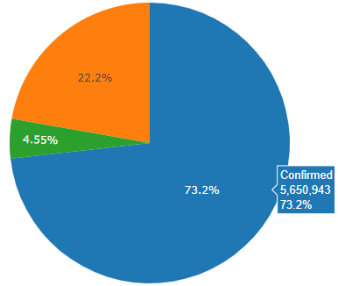
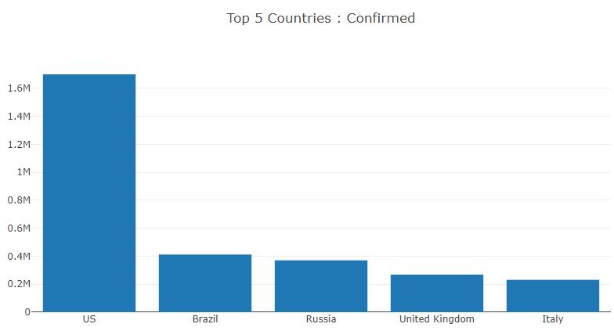
Data Science – Data Frame

Slide 31
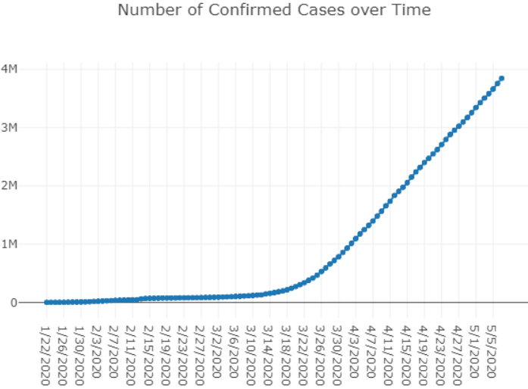
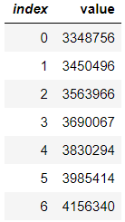
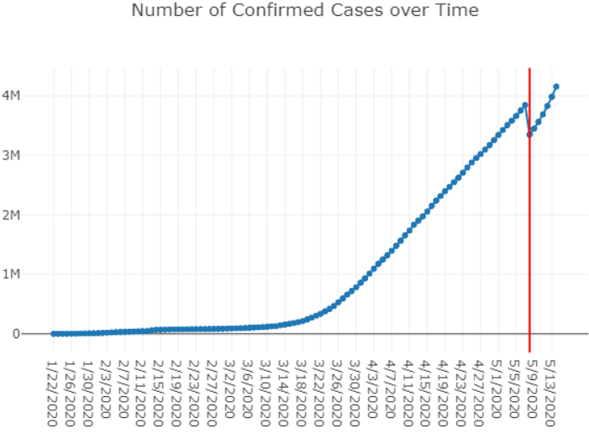
Machine Learning : ML.Net – Prediction (7 days)

Slide 32
Demo

Slide 33
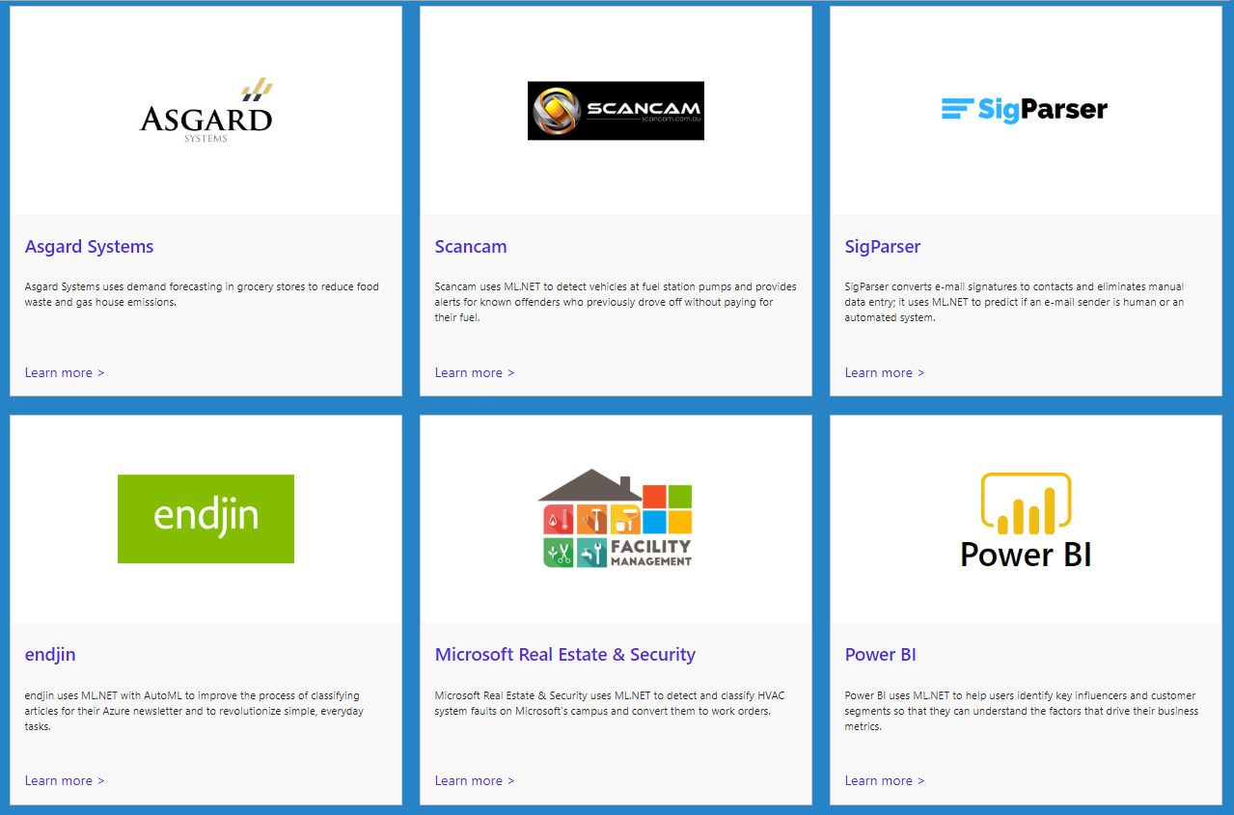
ML.Net : Customer Stories
https://dotnet.microsoft.com/apps/machinelearning-ai/ml-dotnet/customers

Slide 34
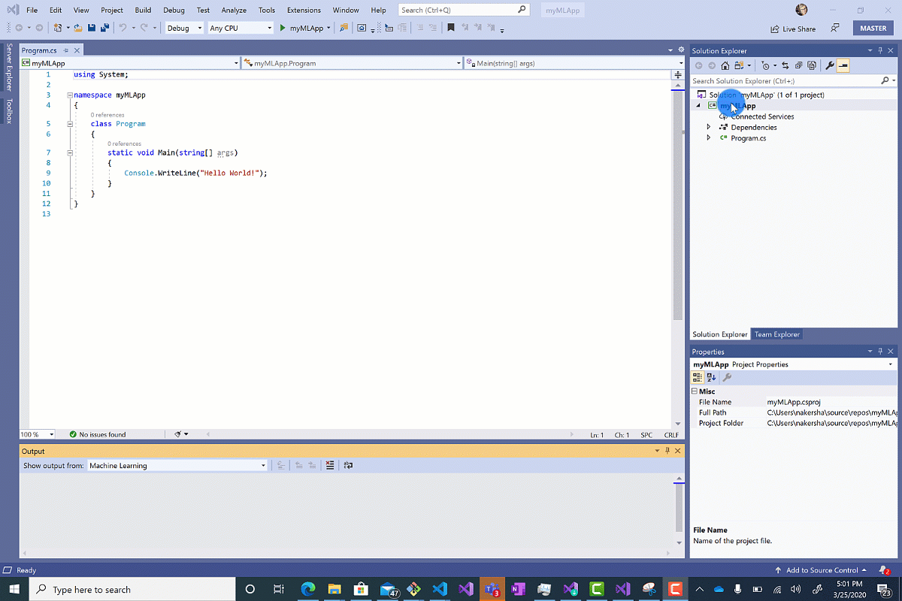
ML.Net : Model Builder(AutoML)

Slide 35
References
ML.Net : https://dotnet.microsoft.com/apps/machinelearning-ai/ml-dotnet
ML.Net: https://devblogs.microsoft.com/cesardelatorre/what-is-ml-net-1-0-machine-learning-for-net/
ONNX : https://onnx.ai/
Photo-Search (ONNX) : https://github.com/Tak-Au/Photo-Search
Music Repair : https://www.youtube.com/watch?v=nnV-1q-z9uE
ML Cookbook : https://github.com/dotnet/machinelearning/blob/master/docs/code/MlNetCookBook.md
Deploy to Azure functions : http://luisquintanilla.me/2018/08/21/serverless-machine-learning-mlnet-azure-functions/
https://rubikscode.net/2019/02/18/ultimate-guide-to-machine-learning-with-ml-net/
https://www.youtube.com/watch?v=dojO4zEL9sg
https://www.youtube.com/watch?v=zy7Y9CHji2k
https://dotnet.microsoft.com/apps/machinelearning-ai/ml-dotnet/customers

Slide 36
Resource
Github: https://github.com/praveenraghuvanshi/tech-sessions/tree/master/21102022-AI-ML-using-ml-dotnet-azconf-2022
Dev.to : https://dev.to/praveenraghuvanshi/covid-19-eda-and-prediction-using-net-dataframe-and-ml-net-c-introduction-nlb
https://dotnet.microsoft.com/apps/machinelearning-ai/ml-dotnet/customers

Slide 37






Platinum Partner
Gold Partner
Silver Partner

Slide 38
Q & A

Slide 39
Applying Data Science and Machine Learning using Microsoft .Net
Praveen Raghuvanshi
@praveenraghuvan

